Slide 1

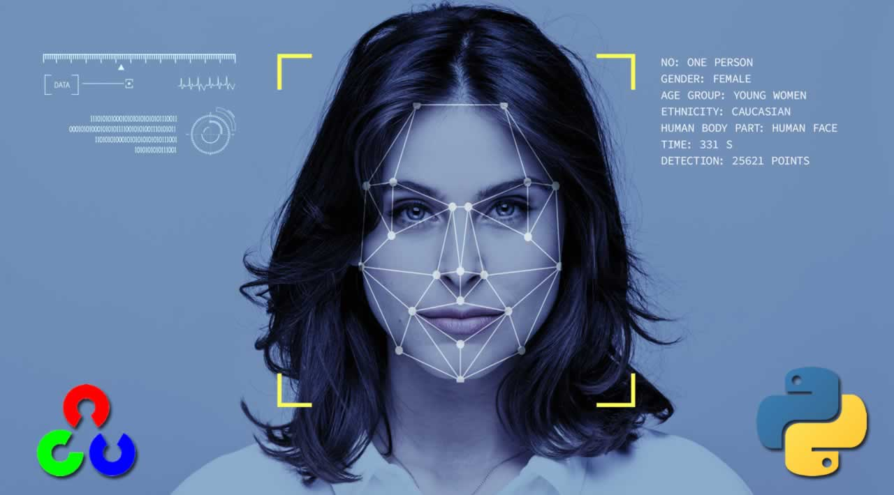
Project Title
Face Recognition using OpenCV
Mentor name: Mr. Rishi Kumar
Submitted by: Chandni Mehta
Roll no: 38
Sec- DS1

Slide 2
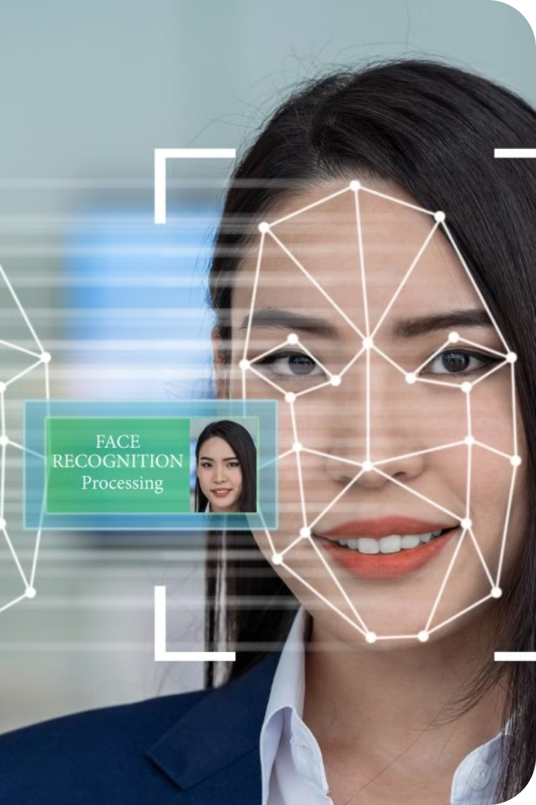
Face Recognition
Face recognition is a powerful biometric technology that has revolutionized the way we interact with technology and secure our personal information. Face recognition is a technology that identifies or verifies a person from a digital image or video. It does this by detecting and analyzing facial features. This technology is used in various applications, such as security, access control, and personal identification.

Slide 3


OpenCV Library Overview
1
Image Processing
Functions for manipulating images, such as resizing, filtering, and color conversion.
2
Feature Detection
Algorithms for identifying key points and features in images, such as edges and corners.
3
Object Recognition
Techniques for recognizing and classifying objects in images and videos.
OpenCV (Open Source Computer Vision Library) is a widely used library for computer vision tasks, including face recognition. It provides a comprehensive set of functions for image and video processing, analysis, and object detection.

Slide 4
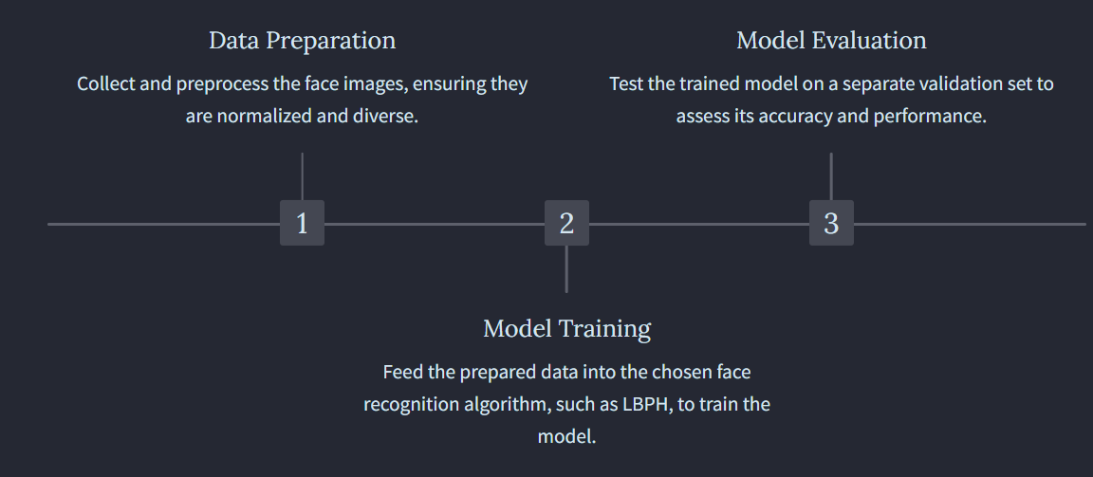
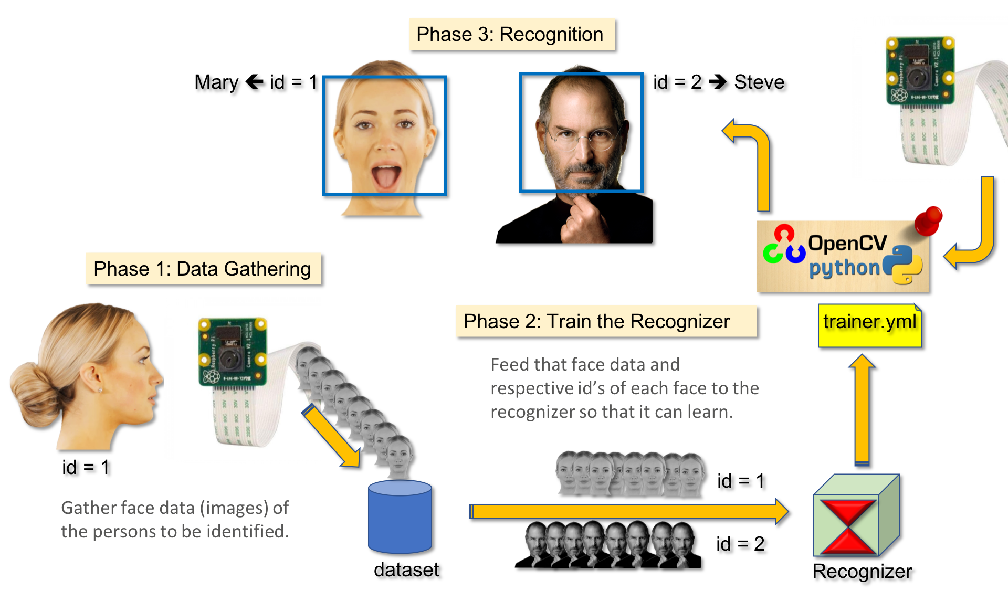
Methodology

Slide 5
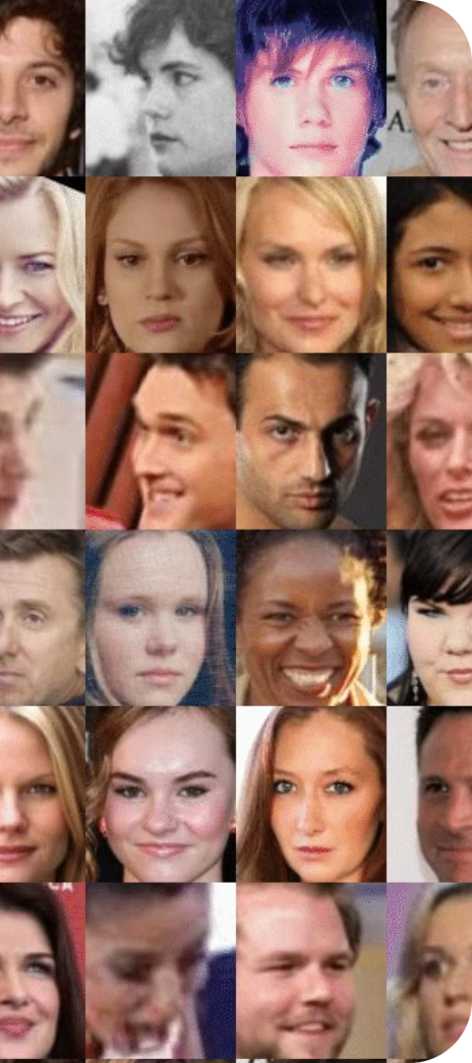



Generating Dataset
Collecting Images
Gather a diverse set of high-quality facial images, ensuring variations in lighting, angles, and expressions.
Labeling and Organizing
Carefully label each image with the corresponding individual's identity to create a structured dataset.
Data Augmentation
Apply techniques like cropping, rotation, and color modifications to increase the size and diversity of the dataset.
Gathering a diverse and representative dataset of facial images is crucial for training accurate face recognition models. This includes collecting images with varying lighting conditions, poses, expressions, and age groups.

Slide 6


Generating Dataset

Slide 7

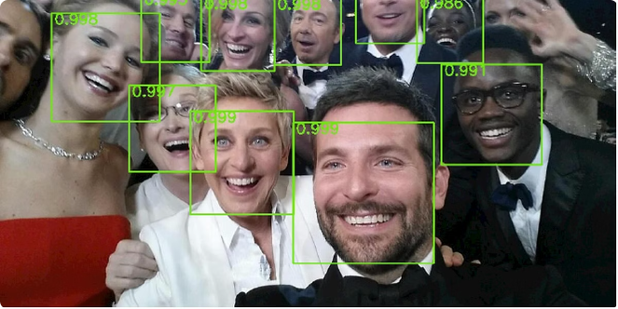
Training Classifier
The Haar Cascade Classifier, a machine learning-based approach developed by OpenCV, is a widely-used technique for face detection.
This technique uses a set of Haar-like features to quickly identify the presence of a face in an image. They rely on a cascade of trained classifiers, each specialized in detecting specific features of a face, such as eyes, nose, and mouth.
The Local Binary Patterns Histogram (LBPH) algorithm for face recognition.
Facial Detection Algorithms
Facial detection algorithms form the foundation of face recognition systems. These algorithms are responsible for identifying the presence of a face within an image or video frame.

Slide 8

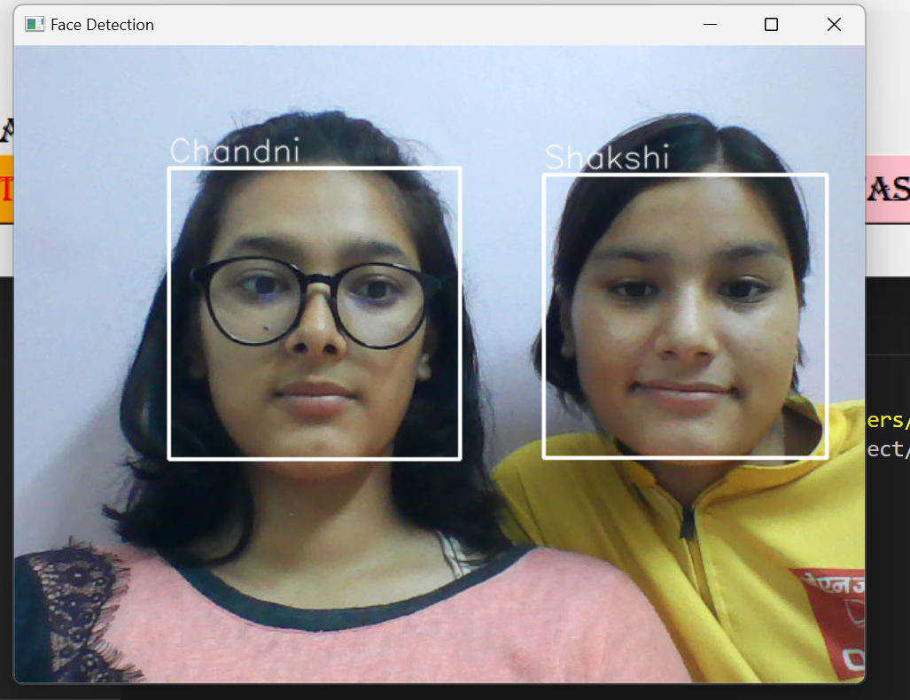
Face Recognizer

Slide 9


Applications and Future Trends
Face recognition technology has a wide range of applications, including:
Security - Access control, surveillance, and crime prevention.
Identification - Personal identification, passport control, and law enforcement.
Mobile Devices - Unlocking smartphones, authentication, and mobile payments.
Retail and Marketing- To personalize the customer experience, analyze customer behavior, and enhance targeted advertising efforts.

